Slide 1
Split-It
Team: Brian Sokol, Logan Skinner, Jacob Tucker, Hanlin Ye, Tzofi Klinghoffer

Slide 2
Problem Definition
Splitting costs is difficult
Who owes what to whom
Receipts
Notes:
Jacob

Slide 3
Scope
80% of retail stores
OCR (specifically BlinkReceipt)
User verification
Azure
Maintain state and concurrency
Notes:
Jacob

Slide 4
Description
OCR receipt
Assign Items
Perform calculations
Set Balances
Notes:
Brian

Slide 5
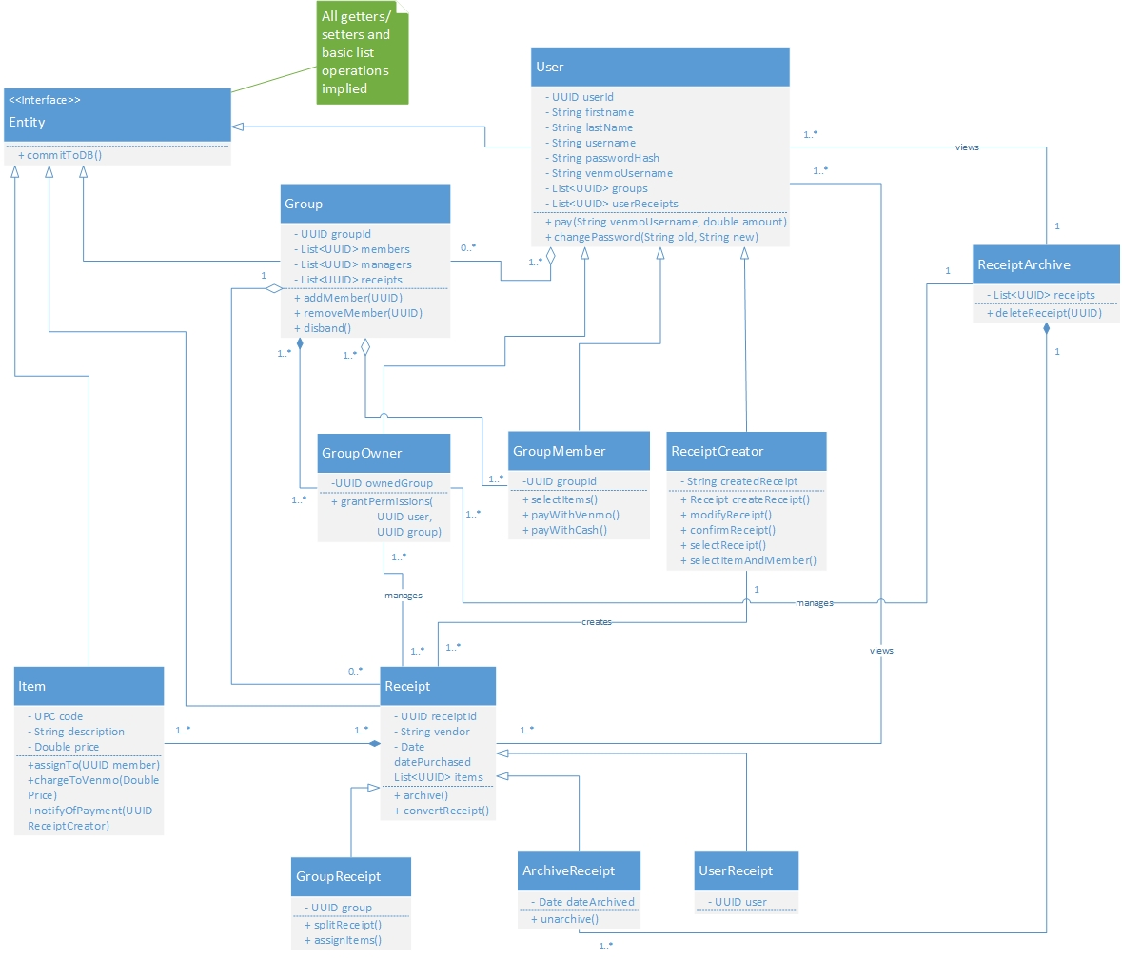
Notes:
Jacob

Slide 6
Notes:
Jacob

Slide 7
Notes:
Jacob

Slide 8
Notes:
Jacob

Slide 9
Notes:
Jacob

Slide 10
Notes:
Jacob

Slide 11
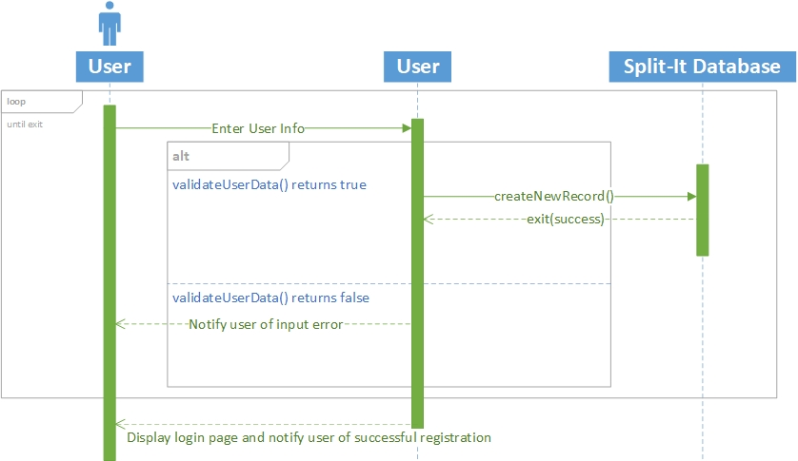
User Registration
Notes:
Brian

Slide 12
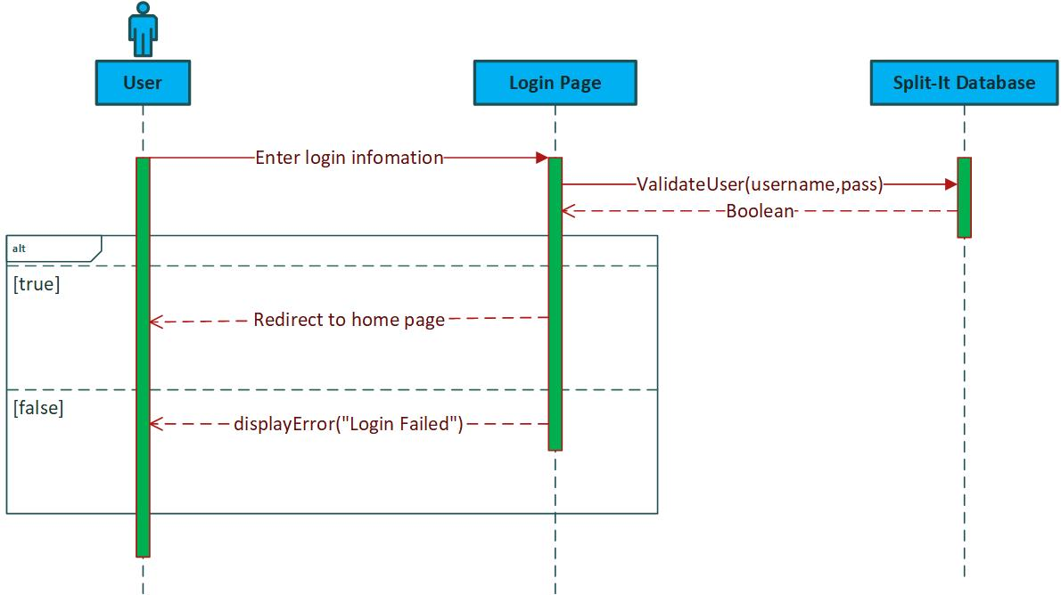
User Login
Notes:
Logan

Slide 13
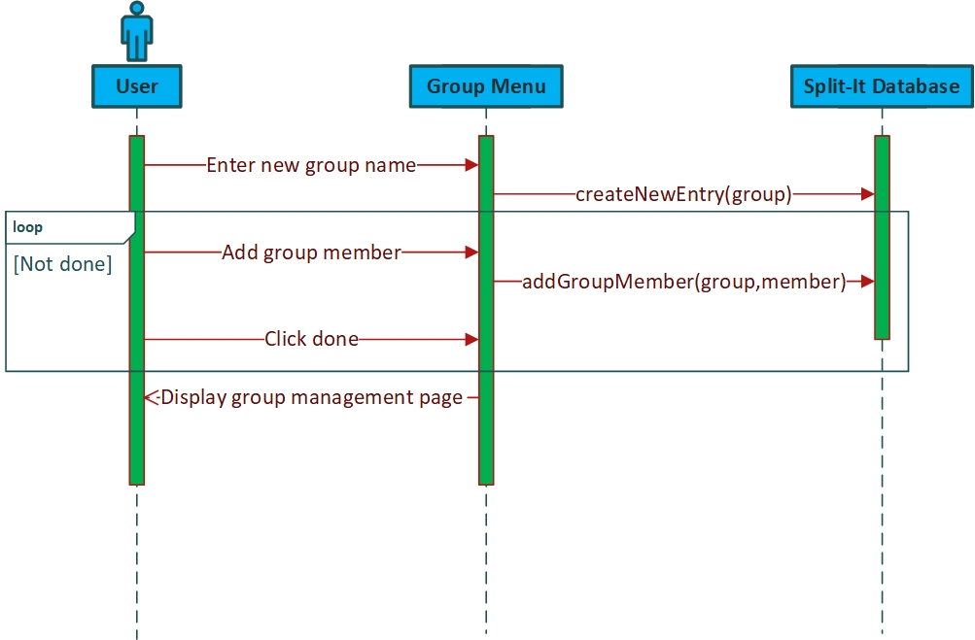
Group Creation
Notes:
Logan

Slide 14
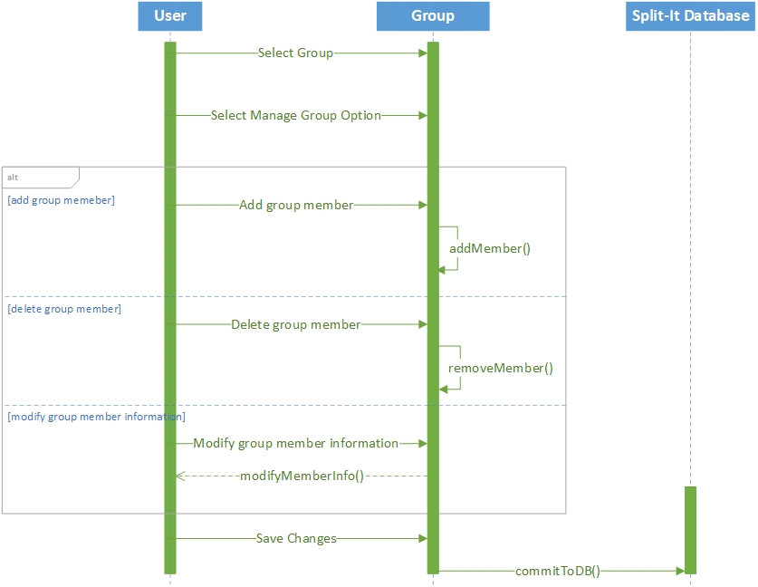
Manage Group
Notes:
Brian

Slide 15
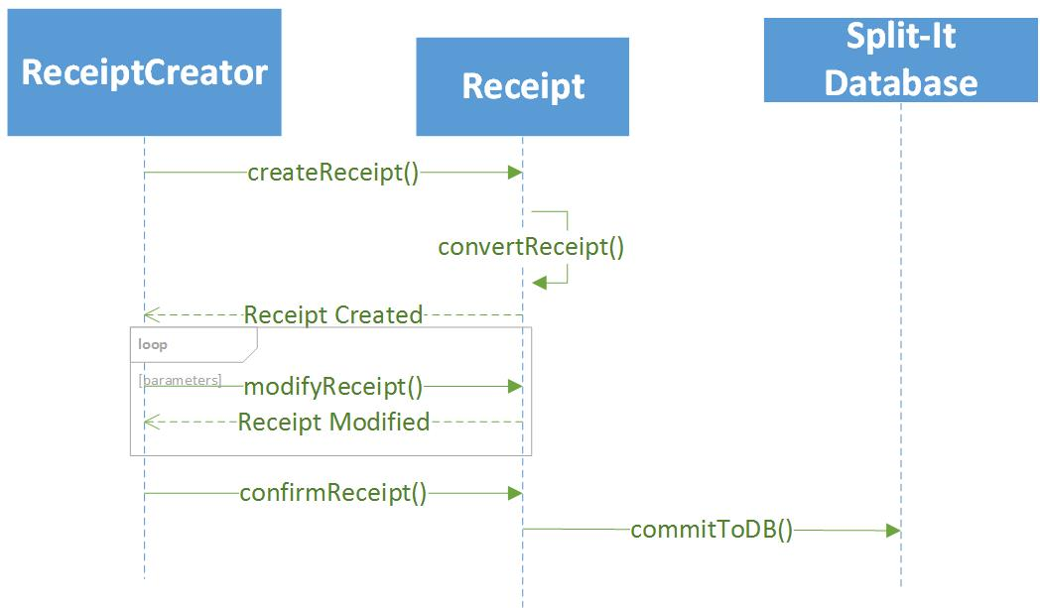
Add Receipt
Notes:
Tzofi

Slide 16
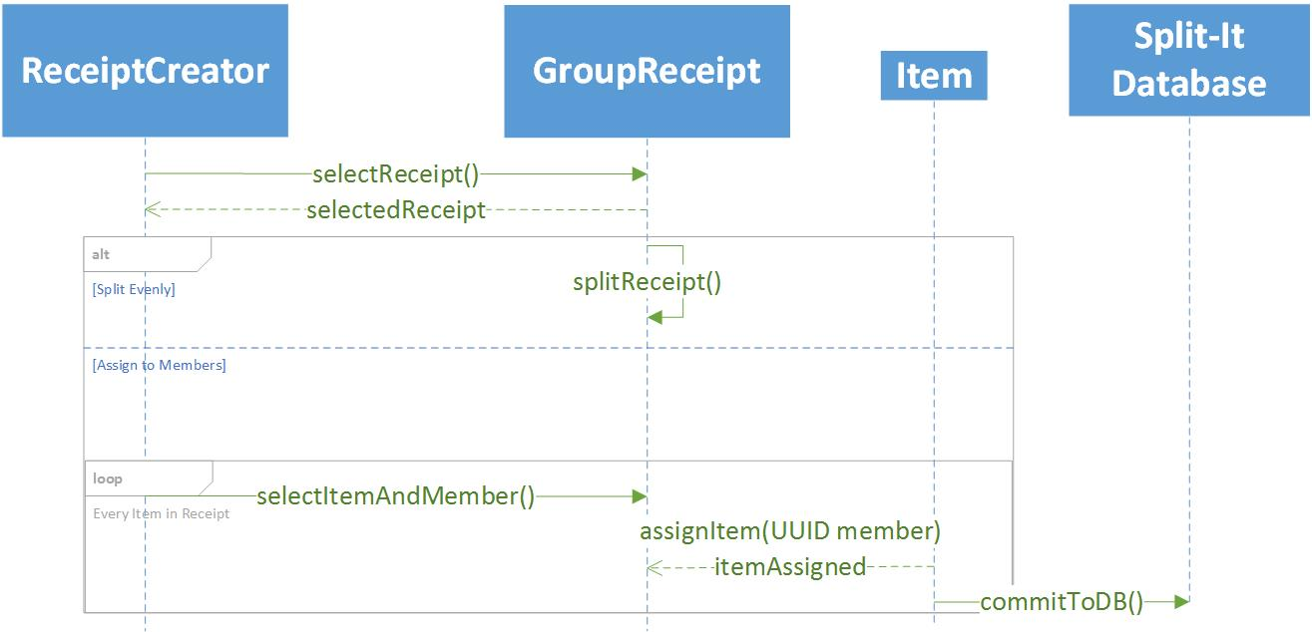
Assign Items
Notes:
Tzofi

Slide 17
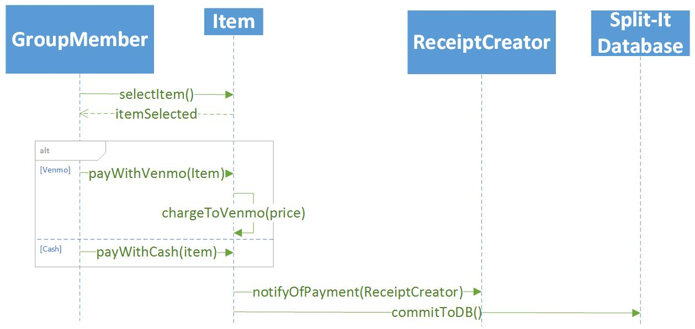
Payment
Notes:
Tzofi

Slide 18
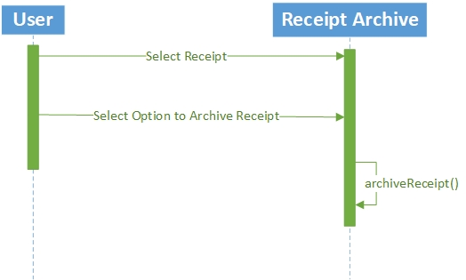
Receipt Archive
Notes:
Brian

Slide 19
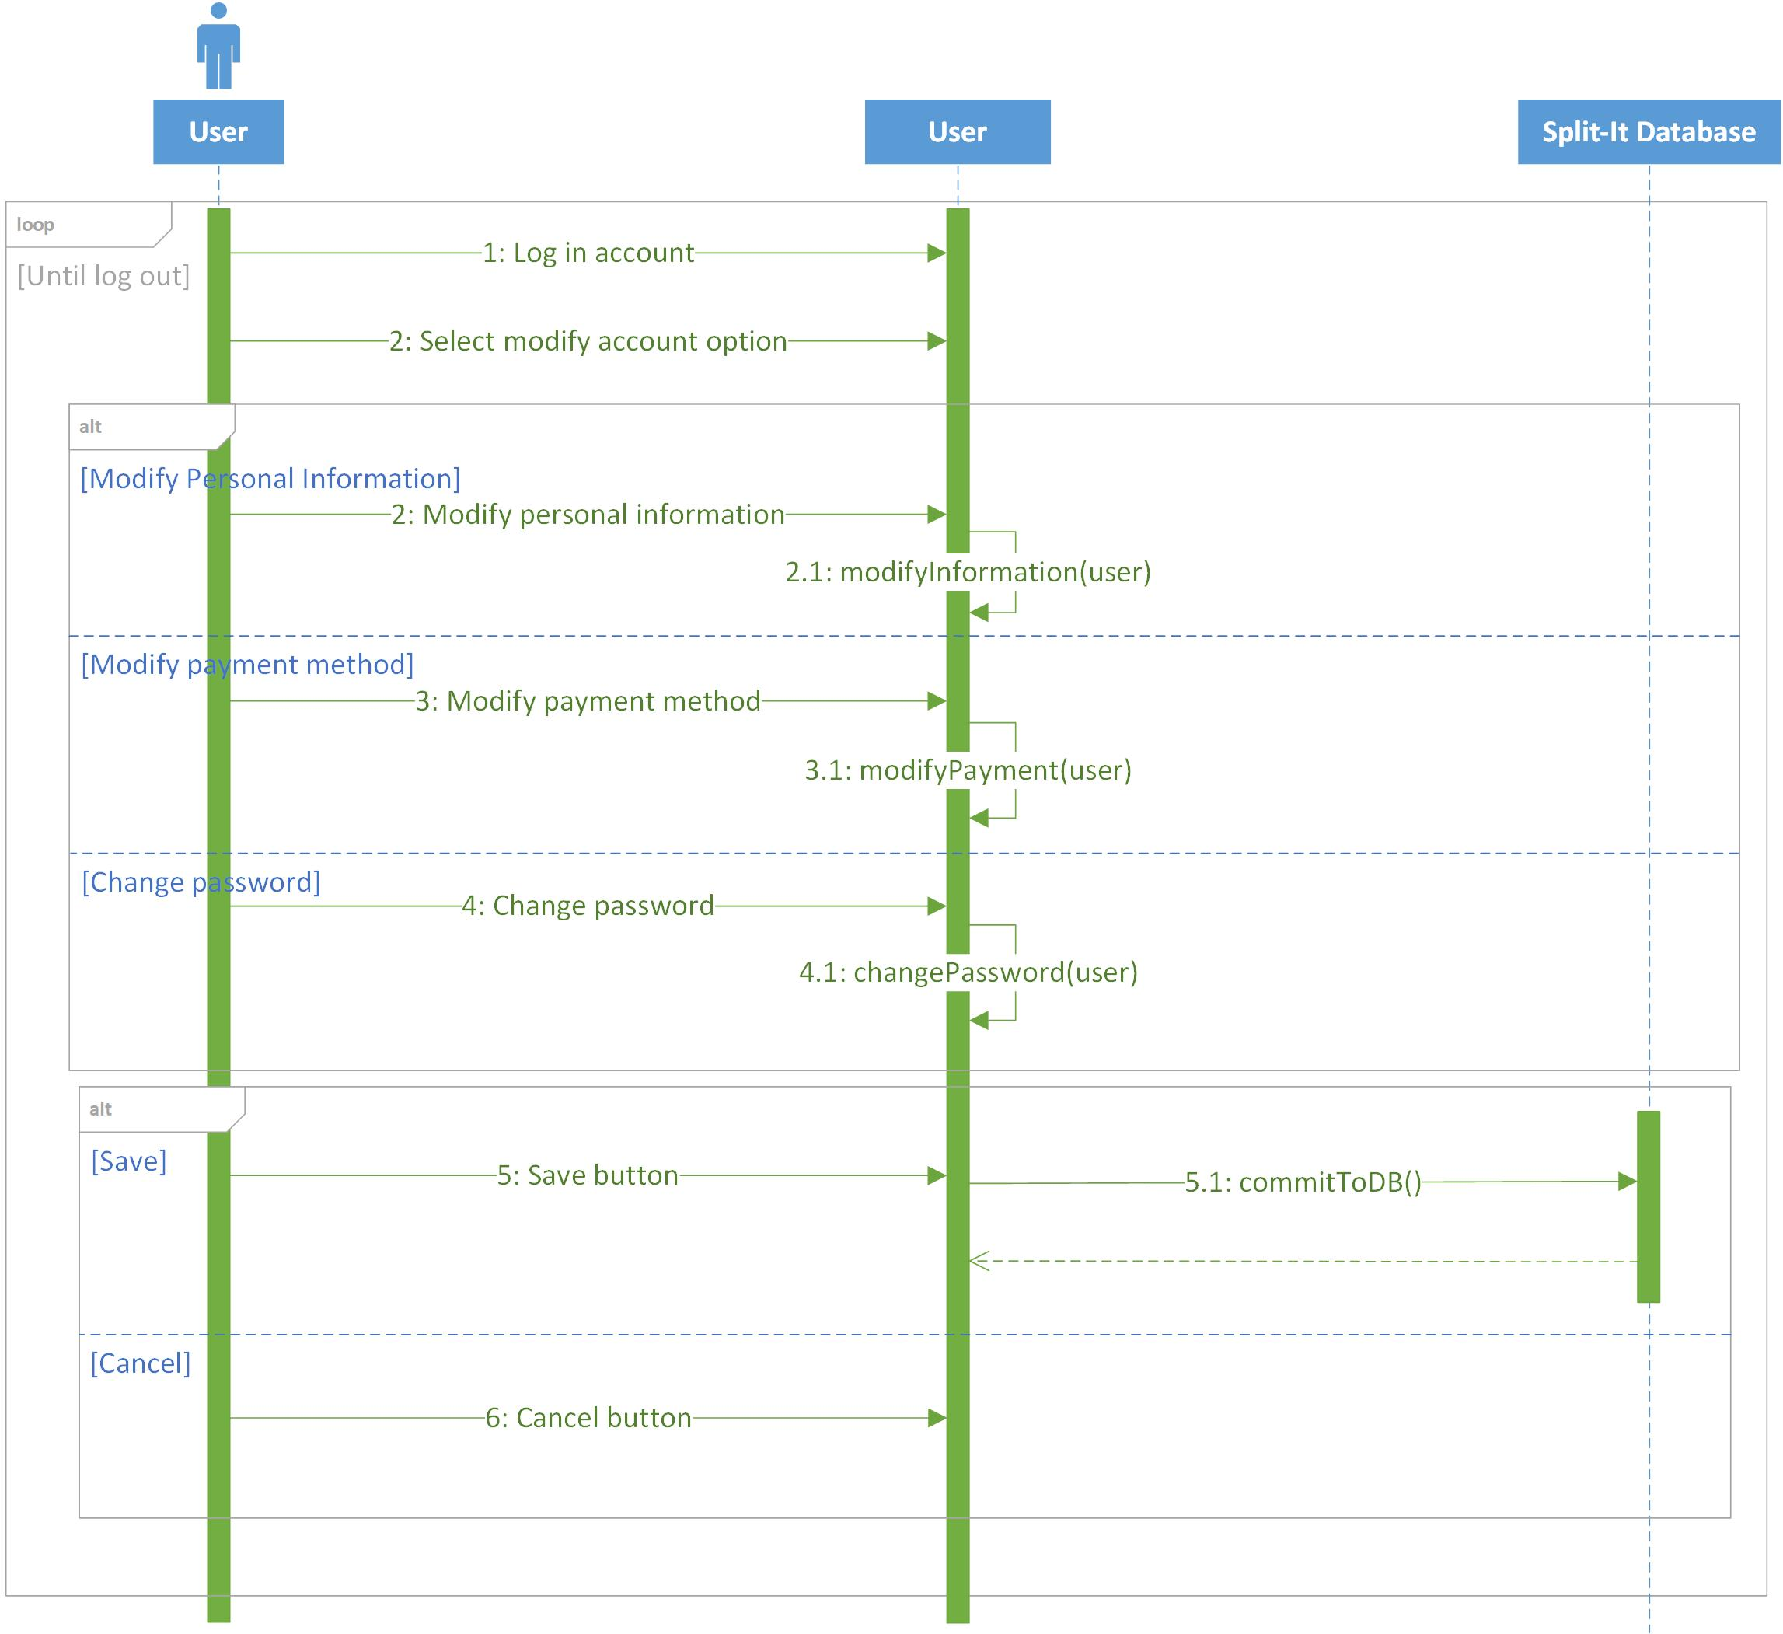
Modify Account
Notes:
Charlie

Slide 20
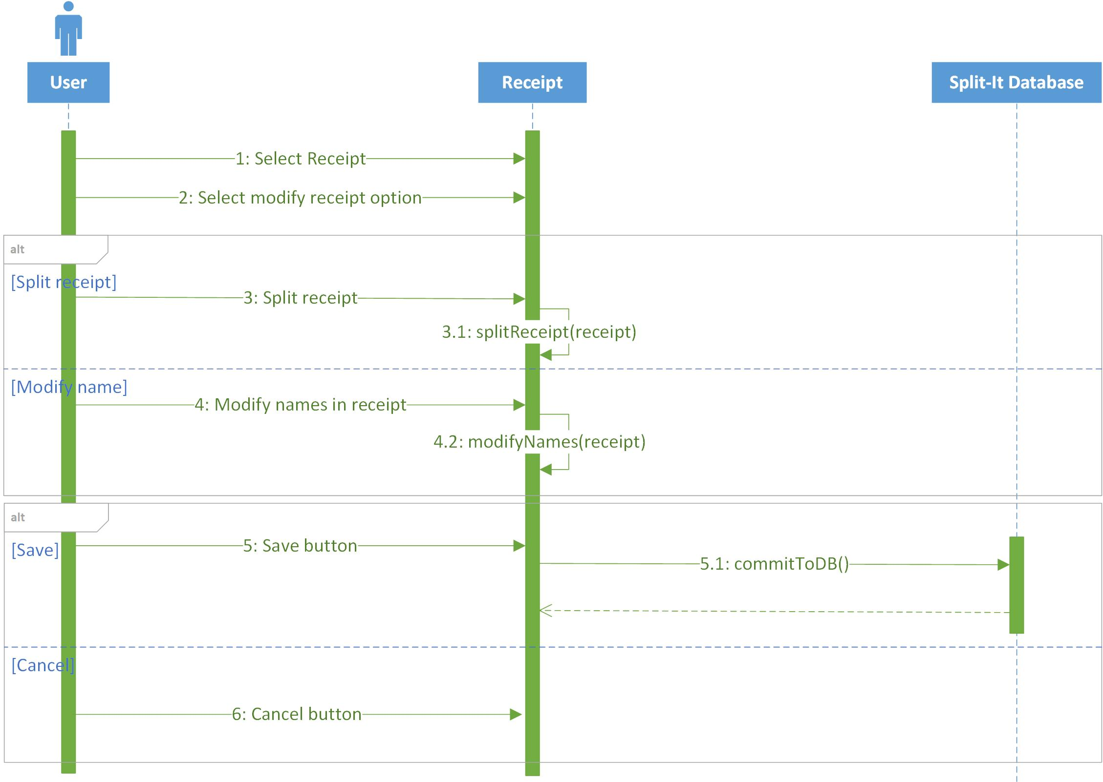
Modify Receipt
Notes:
Charlie

Slide 21
Project Changes
Still on track
Have not removed any features
Recently shifting focus from documentation to coding
Notes:
Tzofi

Slide 22
Summary
We have started coding
Still have significant work to do before the demo
Notes:
Logan

